Slide 1
AI-Augmented Compliance Auditing for Cloud Systems
A hybrid ML-LLM approach for Rwanda NCSA controls
Research Project Course Presentation | May 06, 2026
Moise Iradukunda Ingabire MSIT, Carnegie Mellon University Africa
Supervisor: Prof. Jema David Ndibwile Manuscript status: submitted to Future Internet; under peer review / major revision refresh
1

Slide 2
Today's story
Keep the talk anchored on the new validated results, not the stale abstract numbers.
1
2
3
4
Problem
Gap
Solution
Evidence
Audits verify presence, not whether controls work.
Vocabulary-based ML collapses across log formats.
Hybrid XGBoost + LLM + deterministic decision engine.
Clean XGBoost, n=800 LLM eval, 5 MITRE scenarios.
One-line thesis: The contribution is an honest, low-cost hybrid architecture that detects domain shift and routes evidence to the right analysis path.
AI-Augmented Compliance Auditing | Research Project Course | Moise Iradukunda Ingabire
2/15

Slide 3
Research problem
Manual compliance auditing is slow, expensive, and often checkbox-driven.
Audit burden
Budget pressure
Control scope
Core flaw
1000+ h
40%
143
Presence != Effectiveness
reported annual manual audit effort
IT security budget consumed by compliance
Rwanda NCSA controls modeled
installed controls can still fail
Why this matters
Research question
A firewall, WAF, or EDR can be present but fail against real attack behavior. The research asks how to move from checkbox compliance to measured control effectiveness.
Can a low-cost hybrid ML-LLM auditor map heterogeneous evidence to Rwanda NCSA controls and expose effectiveness gaps under realistic logs and adversarial tests?
AI-Augmented Compliance Auditing | Research Project Course | Moise Iradukunda Ingabire
3/15

Slide 4
Literature review: what is missing?
Existing tools solve pieces; few combine evidence mapping, semantic logs, and adversarial effectiveness.
Approach | Strength | Gap addressed
OpenSCAP / CIS-CAT | Rule checks | No semantic/OOD log reasoning
Wazuh / SIEM rules | Operational detection | Limited regulatory effectiveness scoring
BERT / LSTM log ML | High accuracy in-domain | GPU and domain-shift costs
Commercial GRC | Workflow management | High cost; little adversarial validation
This research | Hybrid ML-LLM + NCSA mapping | Still needs institutional pilot validation
Positioning
The work is strongest when framed as a reference architecture and validation pipeline for resource-constrained national compliance programs, piloting from Rwanda NCSA.
AI-Augmented Compliance Auditing | Research Project Course | Moise Iradukunda Ingabire
4/15

Slide 5
Control taxonomy and evidence mapping
The taxonomy is the bridge between raw logs and trainable compliance labels.
Access Control
Audit & Accountability
Configuration Mgmt.
AC
AU
CM
52 controls | 35 system-auditable
30 controls | 22 system-auditable
18 controls | 12 system-auditable
Identity/Auth
System/Comm. Protection
System Integrity
IA
SC
SI
15 controls | 10 system-auditable
26 controls | 15 system-auditable
2 controls | 2 system-auditable
Training mapping example
Failed SSH login -> AC-7 lockout, IA-2 authentication, AU-2 audit event, SI-4 monitoring
One log can activate multiple controls; binary labels lose compliance structure.
AI-Augmented Compliance Auditing | Research Project Course | Moise Iradukunda Ingabire
5/15

Slide 6
Proposed research solution
Use the right analysis path for the right evidence type.
XGBoost v2
structured in-vocab logs
Evidence Sources
syslog / Windows HTTP / docs
Normalize + Enrich
EventID -> meaning fields -> context
Router
coverage + confidence
Decision Engine
NCSA thresholds 3-way status
Audit Report
evidence, gaps remediation
LLM Analyzer
ambiguous / OOD semantic logs
Core research claim
XGBoost is efficient but vocabulary-bound; LLM semantic analysis handles heterogeneous logs after normalization.
AI-Augmented Compliance Auditing | Research Project Course | Moise Iradukunda Ingabire
6/15

Slide 7
Current validated results
These are the numbers to present today.
Clean XGBoost v2
GPT-4o-mini
Windows enrichment
MITRE validation
85.45%
94.75%
3.0 -> 97.5%
92.8%
held-out test F1
macro accuracy, n=800
bare EventID to description
5-scenario macro detection
Presentation framing
The contribution is not a perfect model. It is a defensible hybrid architecture that exposes domain shift, normalizes evidence, and routes logs to the right analysis path.
AI-Augmented Compliance Auditing | Research Project Course | Moise Iradukunda Ingabire
7/15

Slide 8
Peer review forced a stronger result
The old near-perfect metric was not defensible; the clean model is.
XGBoost after leakage cleanup
Clean model is credible: lower performance, but defensible.
Item | Status
Old issue | Synthetic leakage inflated the headline F1
Fix | Regenerated leakage-free data; removed leaky features
New result | Clean XGBoost v2 test F1 = 85.45%
Interpretation | Credible baseline in the expected 70-90% range
100.0%
100
85.2%
85.5%
87.1%
80
60
40
20
0
Leaky old claim
Clean v2 CV F1
Clean v2 test F1
Clean v2 test acc.
How to say it: reviewers were right to challenge the perfect score; the revision now reports the honest model behavior.
AI-Augmented Compliance Auditing | Research Project Course | Moise Iradukunda Ingabire
8/15

Slide 9
XGBoost still has a role
It is fast and useful for structured, in-distribution evidence.
Performance varies by control family
What the chart means
Per-family F1 from leakage-free held-out test set.
100.0%
100.0%
The clean XGBoost model is not the universal compliance brain. It is the low-latency fast path for log families with vocabulary overlap and structured evidence.
100
92.2%
89.5%
88.7%
88.0%
87.2%
84.8%
80
60
Design decision
40
When vocabulary coverage is weak, route to the semantic LLM path before the Decision Engine makes the control verdict.
20
0
IA
MP
MA
PS
SA
SP
AT
AC
AI-Augmented Compliance Auditing | Research Project Course | Moise Iradukunda Ingabire
9/15

Slide 10
LLM semantic analysis closes the format gap
Current GPT-4o-mini evaluation: 800 samples, 4 log types, Wilson confidence intervals.
LLM semantic path handles heterogeneous logs
GPT-4o-mini macro accuracy: 94.75%; n=800
100
97.5%
95.5%
96.5%
89.5%
80
60
40
20
0
SSH Auth
Windows Events
HTTP/API Access
macOS System Service Logs
AI-Augmented Compliance Auditing | Research Project Course | Moise Iradukunda Ingabire
10/15

Slide 11
Key architectural finding: normalize before reasoning
Bare EventID integers are not enough; descriptions unlock semantic classification.
Windows EventID normalization changes the result
GPT-4o-mini on Mordor Windows Security Events, n=200
Presentation point
100
97.5%
Do not claim the LLM magically understands every raw enterprise log. The system must enrich Windows EventIDs into natural-language security context before LLM classification.
80
60
40
This supports the hybrid design: normalization is not preprocessing trivia; it is part of the compliance reasoning architecture.
20
3.0%
0
Bare EventID
EventID + Description
AI-Augmented Compliance Auditing | Research Project Course | Moise Iradukunda Ingabire
11/15

Slide 12
Effectiveness validation: 5 MITRE ATT&CK scenarios
The system tests whether controls work, not only whether they exist.
Expanded adversarial validation
MITRE | Scenario | Detection
T1059.001 | PowerShell Fileless Shell | 86.0%
T1190 | XSS/SQLi WAF Bypass | 100.0%
T1110 | SSH Brute Force | 100.0%
T1078 | Lateral Movement Valid Accou | 100.0%
T1562.001 | Impair Defenses: Disable Too | 78.0%
Macro detection rate: 92.8%
100.0%
100.0%
100.0%
100
86.0%
80
78.0%
60
40
20
0
T1059.001
T1190
T1110
T1078
T1562.001
Framing: this turns compliance into measured control effectiveness under attack behavior.
AI-Augmented Compliance Auditing | Research Project Course | Moise Iradukunda Ingabire
12/15

Slide 13
Dataset provenance for the latest results
Use this slide to explain exactly what evidence supports each headline number.
Result | Dataset / source | Sample size | Current number
Clean XGBoost v2 | Leakage-free regenerated synthetic NCSA logs | 70K train / 15K val / 15K test | 85.45% test F1
LLM semantic eval | SSH auth, Mordor Windows, HTTP/API, macOS logs | 200/type = 800 total | 94.75% GPT-4o-mini
Windows enrichment | Mordor APT3 Windows Security EventIDs | n=200 | 3.0% bare -> 97.5% enriched
Adversarial validation | MITRE T1059.001, T1190, T1110, T1078, T1562.001 | ~50/scenario | 92.8% macro detection
Compliant FPR check | Mordor + Elastic AWS auth + Elastic Apache + LogPai Linux | 100 real compliant logs | 53.0% FPR currently
Important wording
Do not say one dataset produced every result. The honest story is a pipeline evaluation: clean synthetic training for XGBoost, mixed real/generated evaluation for LLM and adversarial tests, and real compliant logs for false-positive analysis.
AI-Augmented Compliance Auditing | Research Project Course | Moise Iradukunda Ingabire
13/15

Slide 14
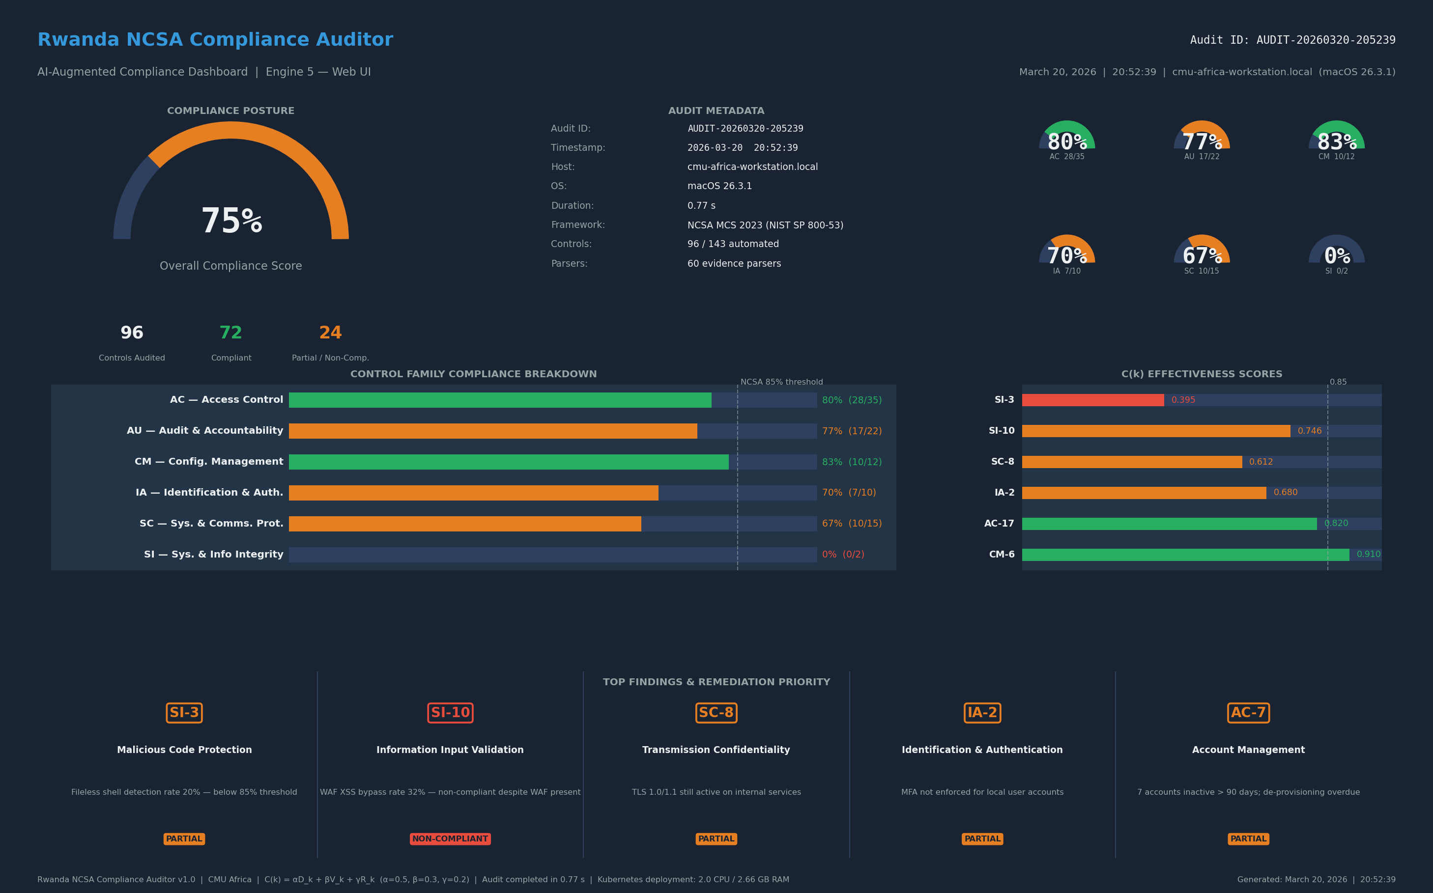
Deployment evidence and research status
Prototype works; paper is being refreshed for peer review.
Live audit
Footprint
Hosting target
Manuscript
0.77 s
2 CPU / 2.66 GB
~$50/mo + API
Future Internet
end-to-end report generation
measured seven-engine system
resource-constrained deployment
submitted; under peer review refresh
Status for the audience
The manuscript/poster abstract still contains older numbers. Today's presentation uses the current local reports: clean XGBoost v2, n=800 GPT-4o-mini evaluation, Windows enrichment, and 5-scenario MITRE validation.
This is a research-in-progress revision, not a production certification claim.
AI-Augmented Compliance Auditing | Research Project Course | Moise Iradukunda Ingabire
14/15

Slide 15
Future improvements
From Rwanda NCSA pilot to model-agnostic African compliance infrastructure.
Horizon | Work planned
Short term | Refresh manuscript results; add supplementary tables; finish reviewer responses
Pilot | Validate on production logs from 2-3 Rwandan institutions
Frontier models | Provider-agnostic adapters for Claude Opus, Gemini, GPT-class, Mistral, Mythos-style models
On-premise | Fine-tune Llama/Mistral-family models for data-sovereignty settings
Pan-African path | Map Rwanda NCSA to ISO 27001, NIST SP 800-53, Kenya, Nigeria, and Malabo-aligned frameworks
Closing line
The long-term vision is not one model or one country: it is a modular compliance-auditing reference architecture for resource-constrained African institutions.
AI-Augmented Compliance Auditing | Research Project Course | Moise Iradukunda Ingabire
15/15

